Slide 1

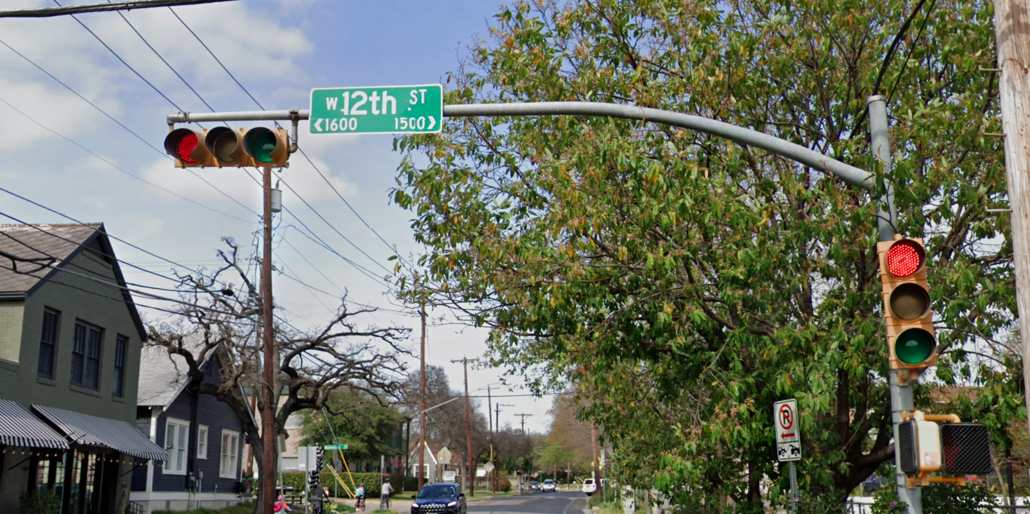
Austin Transportation Department Signs Work Orders
Created By: Susanne Gov Created Date: 2020-08-10 Location Name: 12TH ST / WEST LYNN ST Intersection ID: 5154661 Cardinal Direction: N Work Order ID: SG-20209
Sign Type | Install/Remove
Street Name Sign | Install

Slide 2
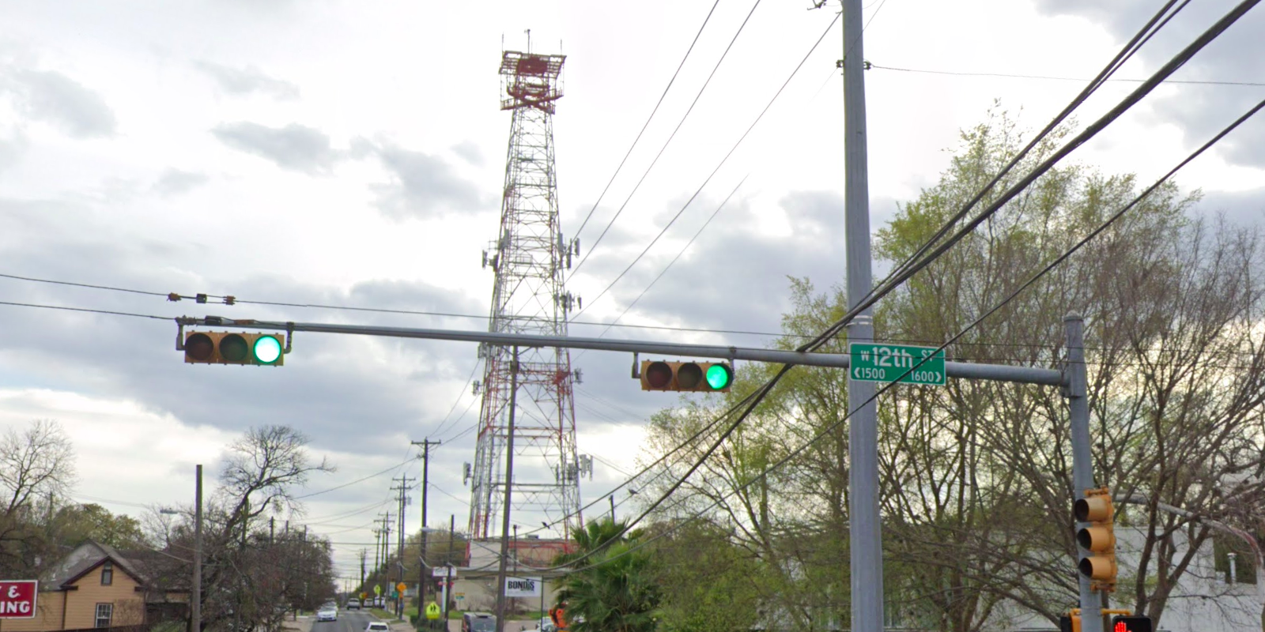
Austin Transportation Department Signs Work Orders
Created By: Susanne Gov Created Date: 2020-08-10 Location Name: 12TH ST / WEST LYNN ST Intersection ID: 5154661 Cardinal Direction: S Work Order ID: SG-20209
Sign Type | Install/Remove
Street Name Sign | Install

Slide 3
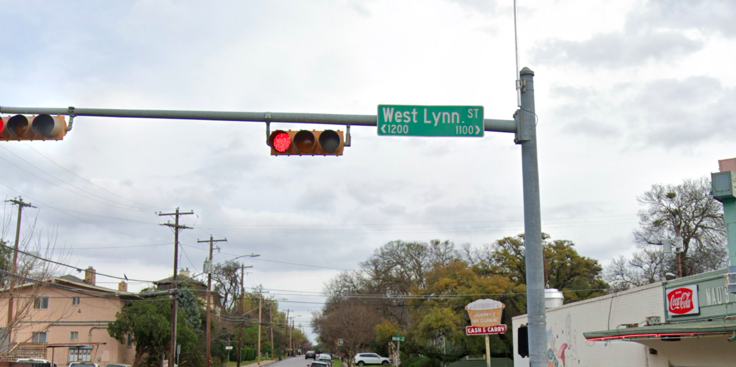
Austin Transportation Department Signs Work Orders
Created By: Susanne Gov Created Date: 2020-08-10 Location Name: 12TH ST / WEST LYNN ST Intersection ID: 5154661 Cardinal Direction: E Work Order ID: SG-20209
Sign Type | Install/Remove
Street Name Sign | Install

Slide 4
Austin Transportation Department Signs Work Orders
Created By: Susanne Gov Created Date: 2020-08-10 Location Name: 12TH ST / WEST LYNN ST Intersection ID: 5154661 Cardinal Direction: W Work Order ID: SG-20209
Sign Type | Install/Remove

